Slide 1


Java ee
(ADVANCE JAVA)
Lecture-48

Slide 2
Today’s Agenda
Introduction To JSP
Servlet v/s JSP
Request Processing In JSP
JSP Tags

Slide 3
INTRODUCTION TO JSP
The term JSP stands for Java Server Pages and it is a dynamic web page generation technology given by sun micro systems in the year 1999 .
The main aim of providing JSP was to simplify the development of the java base web application and remove the drawbacks of servlets .

Slide 4
INTRODUCTION TO JSP
How ever in today’s web development scenario both servlets and JSP have their own importance and should be cordially use in any industry standards based web application.

Slide 5
DRAWBACKS OF SERVLET
In servlets , a programmer has to extend specific servlet class (HttpServlet or GenericServlet) .
Programmer has to provide complete and exact prototype of the method he has to override which are doGet() and doPost() .

Slide 6
DRAWBACKS OF SERVLET
We have to create the mapping of servlet inside web.xml.
In a servlet we embed HTML inside java code i.e all the HTML part is mentioned within the println( ) method which is very difficult since we have to follow all strict rules of java.
Any change in the servlet requires recompilation and redeployment of the application by restarting the server

Slide 7
ADVANTAGES OF JSP
JSP are very small in size as compared to a servlet.
They use some special tags to embed java inside the HTML part and because of this they are much easier to handle compared to a servlet .
A JSP page gets automatically compiled by the container so we don’t have to compile it like a servlet.
Moreover they do not require web.xml for themselves i.e. no mapping is needed .
Also any change made in a jsp page does not require any recompilation or restarting the server. It is handled automatically by the container.

Slide 8
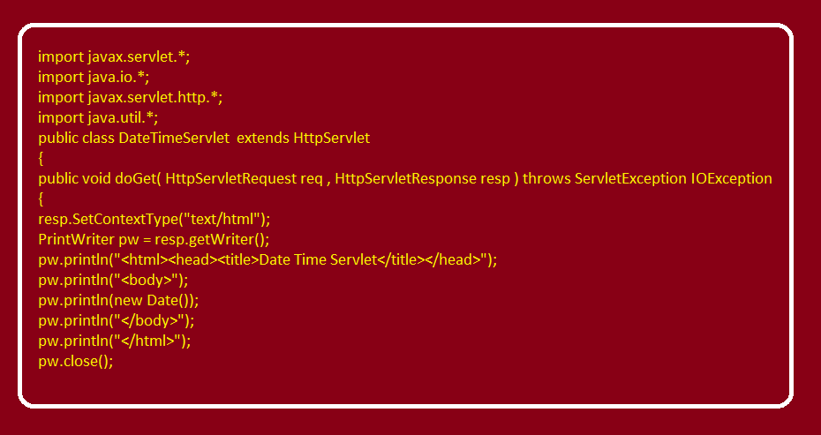
SERVLET FOR DATE TIME

Slide 9
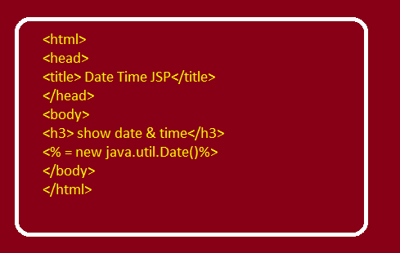
JSP FOR DATE TIME

Slide 10
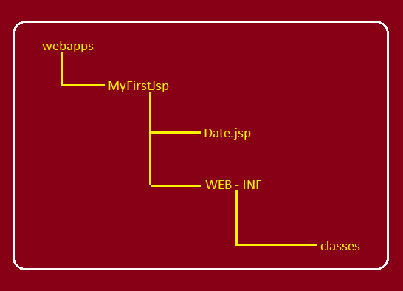
DIRECTORY – STRUCTURE
Request : http://localhost:1980/myfirstjsp/date.jsp

Slide 11
LIFE CYCLE OF A JSP PAGE
A JSP page is converted into a Servlet in order to service requests.
The translation of a JSP page to a Servlet is called Lifecycle of JSP.
JSP Lifecycle is exactly same as the Servlet Lifecycle, with one additional first step, which is, translation of JSP code to Servlet code.

Slide 12
LIFE CYCLE OF A JSP PAGE
Following are the JSP Lifecycle steps:
Translation of JSP to Servlet code.
Compilation of Servlet to bytecode.
Loading Servlet class.
Instantiating the servlet .
Initialization by calling jspInit() method
Request Processing by calling _jspService() method
Destroying by calling jspDestroy() method

Slide 13
DESCRIPTION
Translation Phase : When first request of a jsp page comes then the container translates .jsp page into .java file
Ex : showdate.jsp to showdate_jsp.java .
Compilation Phase : Immediately after translation the compilation of servlet to produce .class file is done by the container .
Loading Phase: As soon as the compilation is done , the .class file is loaded in server’s memory

Slide 14
DESCRIPTION
4. Instantiation Phase : Then the object of servlet is created
5. Initialization Phase : Now the container calls the jspInit() method to initialize the servlet instance
Request processing Phase : A new thread is then created, which invokes the_jspService() method, with request (HttpServletRequest) and response (HttpServletRespnse) objects as parameters.
Now for every next request only the 6th step is executed . However if the jsp page is edited then again all the previous steps are repeated
7. Destruction Phase: This phase comes when the container decides it no longer needs the servlet instance to service requests. It then calls jspdestroy() method and the servlet is ready for a garbage collection

Slide 15
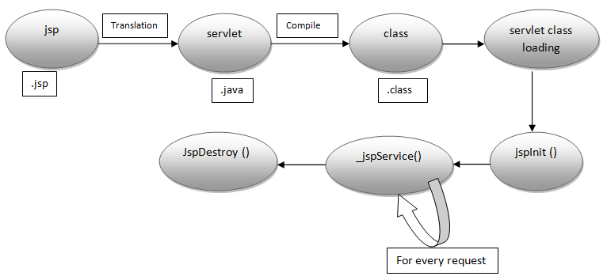
HOW A JSP PAGE IS PROCESSED BY CONTAINER ?

Slide 16
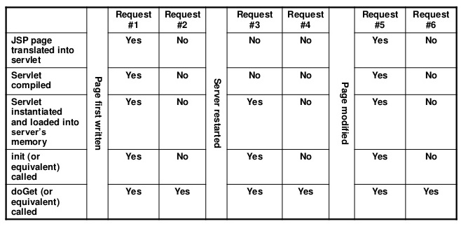
HOW A JSP PAGE IS PROCESSED BY CONTAINER ?

Slide 17

End Of Lecture
For any queries mail us @: scalive4u@gmail.com
Call us @ : 0755-4271659, 7879165533
Agenda for Next Lecture:
Types of JSP Elements
Scriptlets
Declarative Tags
Expression Tags

